Slide 1
ICS 141 – Programming With Objects
Lecture 9 – Robert Jahn

Slide 2
File I/O
We’ve seen we can gather input from the user in two ways.
Scanner objects linked to the command line.
GUI input with text fields.
Now we are going to look at a third way to grab input for our programs.
Java’s extensive file I/O library gives us the tools to effectively open files, parse the text within the file, generate some output, and send that output to the user, or even an output file.
We introduce this hand-in-hand with exception handling, as we are highly likely to run into exceptions when doing this work.

Slide 3
A Few Classes to Help with these Tasks.
Scanner
Will read in the file contents.
PrintWriter
Will write to a file.
File
Represents a file object. Helps us in opening/closing files of interest.
As we talked about last week, there are a few other classes we could use (BufferedReader and BufferedWriter for instance). However, these will be the simplest, so we’ll start with these.
We’ll also just work with .txt files for the time being.

Slide 4
The File Class
The File class is intended to provide an abstraction that deals with most of the machine-dependent complexities of files and path names in a machine-independent fashion. The filename is a string. The File class is a wrapper class for the file name and its directory path.

Slide 5
The File Class
For instance, consider one of the major differences between Unix and Windows operating systems.
In Unix, the file separator is the slash: /root/Bob/HW
In Windows, it is the backslash: \Users\Bob\HW
Changes such as these will be abstracted away by the File class. This way, we can approach solutions in way that is independent of the OS being used. This will also allow us to more generally use the same solution across different systems.

Slide 6
FILE Class

Slide 7
Syntax
Just as we’ve seen all along, creating a File object follows the same syntax.
We declare a reference variable and have it point to a new File object.
We’ll create the File object by passing it a String.
This String will be our pathname.
Note: The pathname must be seeable from the default directory.
In Eclipse, this is in the Eclipse project directory.
For those that use NetBeans, I assume that this is the same.

Slide 8
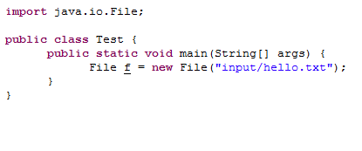
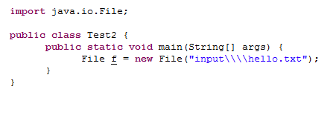
Syntax
Which is preferable?
For the sake of simplicity, the first version, the Unix version with the forward slash, would be preferable.
Note the complexity of the Windows version. We need 4 backslashes to represent a single backslash. This is because the backslash, in Java is an escape sequence (\n or \t for instance). However, it is also a special character in regular expressions. So, to get a single backslash to appear, we need 4 overall.

Slide 9
Text I/O
A File object encapsulates the properties of a file or a path, but does not contain the methods for reading/writing data from/to a file. In order to perform I/O, you need to create objects using appropriate Java I/O classes. The objects contain the methods for reading/writing data from/to a file. This section introduces how to read/write strings and numeric values from/to a text file using the Scanner and PrintWriter classes.

Slide 10
Reading Data Using Scanner

Slide 11
Scanner Syntax
Correct
Scanner input = new Scanner(new File(“scores.txt”));
Incorrect
Scanner input = new Scanner(“scores.txt”);

Slide 12
Reading from a File
Say we want to read in some data from a text file. Let’s say we know the form of this text file. It will have a person’s full name and score on each line.
John K Smith 90
Wilbur W Wright 85
Joanne T Smithers 95

Slide 13
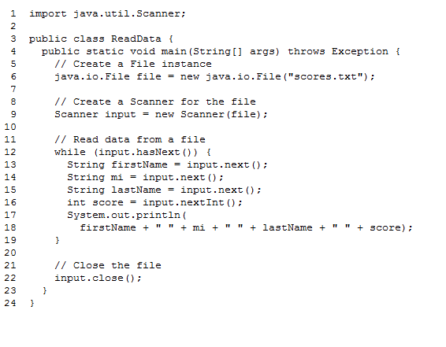
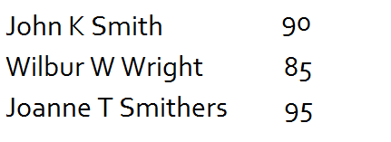
Reading from a File

Slide 14
Writing Data Using PrintWriter

Slide 15
Writing to a File
Suppose we want to write some text to a file. Specifically, we want to write a few names and integer values to a text file. Let’s go through a very basic example to see how we can write to a text file using Java’s File and PrintWriter classes.

Slide 16
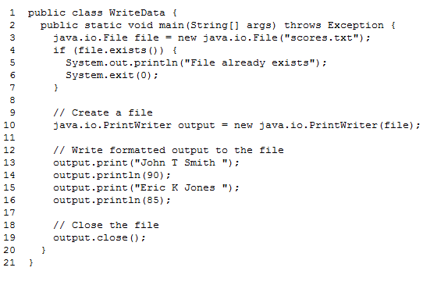
Writing to a File

Slide 17
Close Your Streams
We must always remember to close the streams to our files when we are done.
Otherwise, they’ll remain open after the program has ended.
This may lead to data corruption and a loss of resources.
Syntax
Input.close();
Output.close();

Slide 18
Exceptions
I mentioned early on that we introduce exceptions and file I/O together as they go hand-in-hand.
That is, whenever we are doing file I/O, we are bound to find some use from exceptions.
We will use them in two ways.
Whenever we try to open a file for reading.
When we try to scan in input from a file.

Slide 19
Open a File for Reading
Whenever we specify a file name for the Scanner class to open, there is always the possibility that the file does not exist. If this is the case, we’ll throw a FileNotFoundException.

Slide 20
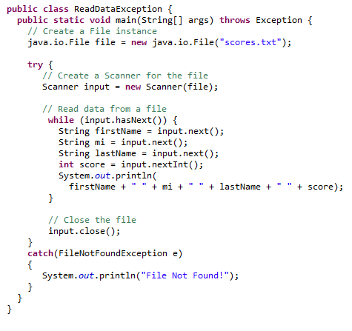
Open a File for Reading

Slide 21
What About Writing to a Non-Existent File?
In this case, we do not have to worry about exceptions
This is because Java will automatically create a file if it does not exist when we wish to write to a file.
If the file does exist, it will be overwritten.
Be careful!

Slide 22
Scanning in Input
We’ll also find it advantageous to use exception handling when parsing the actual contents of a file.
That is, when we expect an int, but get a double, we’ll throw an exception.
Exception handling allows us to easily recover from such an issue.

Slide 23
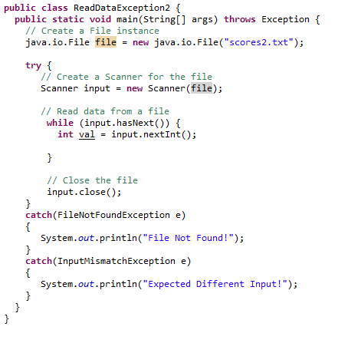
File I/O
This will work, but it is not entirely effective. What happens when we read a non-integer?
Let’s go over a small example in which we gather all integers in a file, discard any non-ints, and calculate the total sum of all integers.

Slide 24
Example
Say we have a txt file which holds a single student’s quiz scores. We want to write up a small program to total these scores. However, we have to be careful for bad input!
5
4
7
8
9
7
8
6
5g
7
4
7.7
5
6

Slide 25
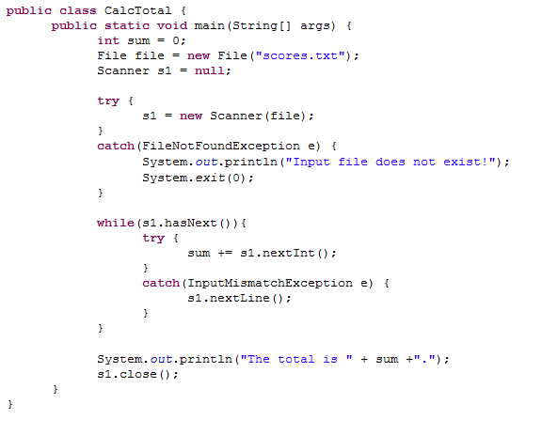
Solution

